Slide 1
MA679
Physical Therapy Project
Week 4: Final Update
William Zen, Zara Waheed, Pruthvi Bharadwaj

Slide 2
Updates for Week 4
We built multiple versions of the models we’ve experimented so far, with different parameters/components :
FPCA
MFPCA
AE
Built a Variational AE
Wrote a training loop with hyperparameter optimisation
Notes:
We focused on two things this week.
Refining the models we have for different reduced dimension sizes
Built a Variational Autoencoder
Wrote a training loop with hyperparameter optimisation

Slide 3
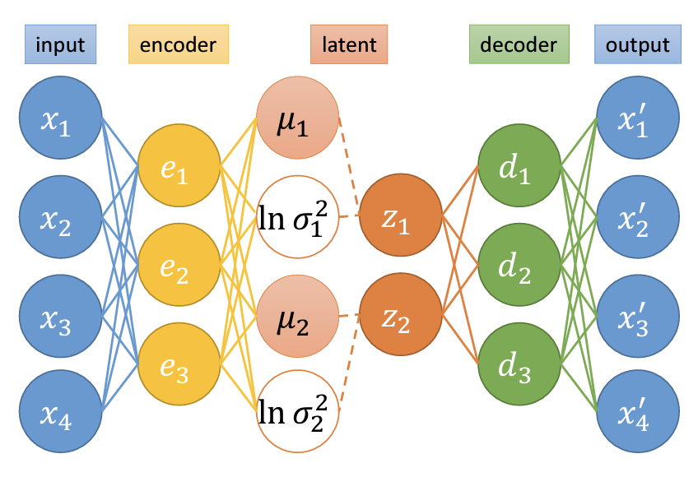
Variational Autoencoder
Notes:
A variational autoencoder has an encoder layer that ends with a latent space rather than a point estimate. This latent space can be thought of as a distribution and the decoder layer is built from samples obtained from the latent space

Slide 4
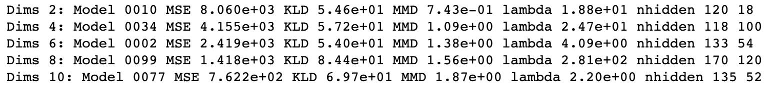
What we did
Trained 100 models each for encoder size 2,4,6,8 and 10
Each model had a randomly chosen lambda and hidden units
Selected the model with best loss value for each dimension
Best models for AP GRF
Notes:
We wrote a training loop that trained 100 models each for different encoder dimension sizes. We then selected the best model for each dimension size. The training function had some aspects of hyperparameter optimization and each model had a different lambda and hidden layer units that were chosen randomly. The best APGRF models for each dimension size is shown here. For 4 dimensions, the VAE had 118 and 100 hidden units in 2 layers respectively.

Slide 5
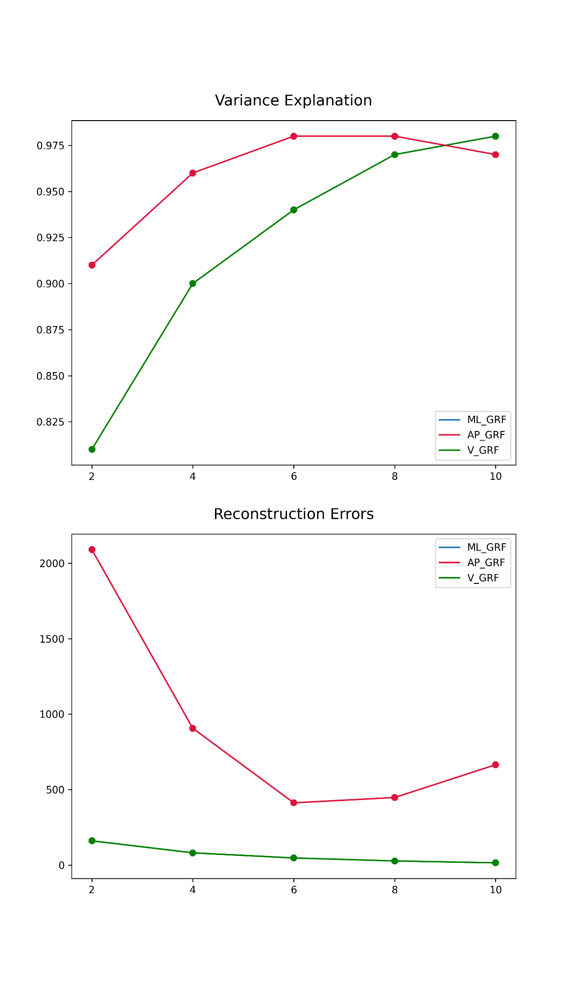
VAE - Reconstruction MSE Plot
Notes:
Reconstruction MSE showed a general decreasing trend as dimensions increased. We are yet to get results for ML GRF, which is why its not seen here. 6 dimensions seems to be good from the plots.

Slide 6
VAE - Variance Explanation Plot
Notes:
Variance explanation (which is R^2) showed a general increasing trend.

Slide 7
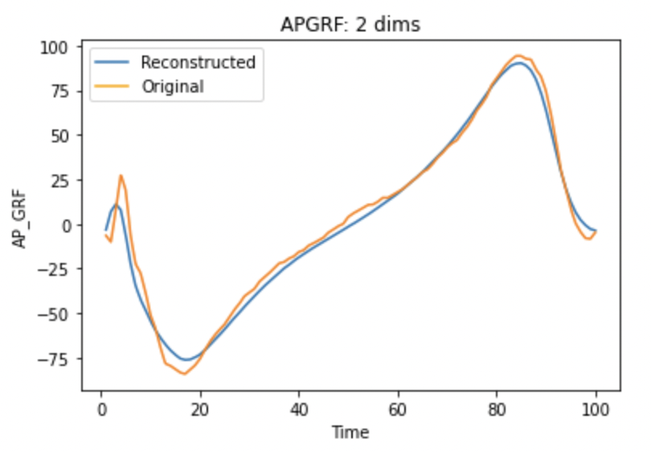
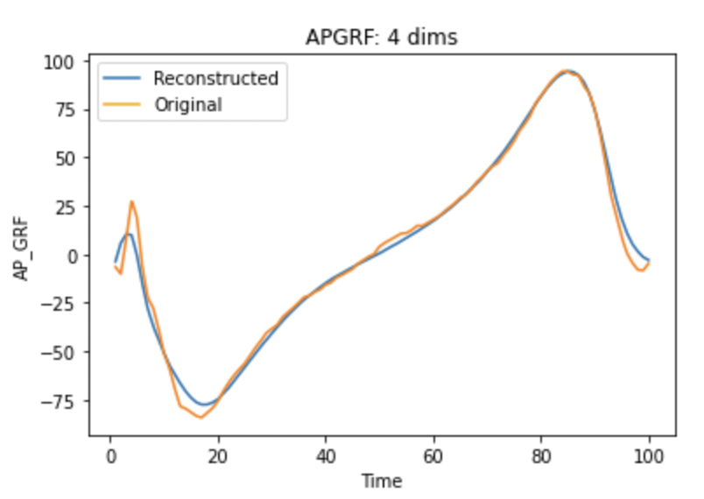
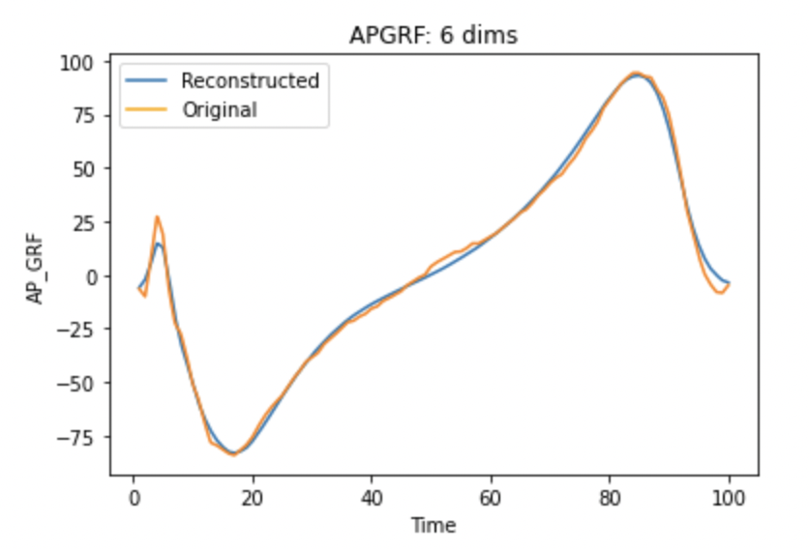
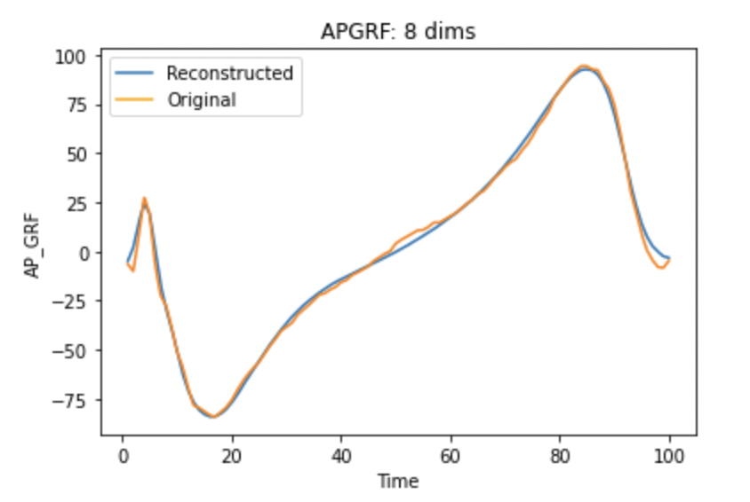
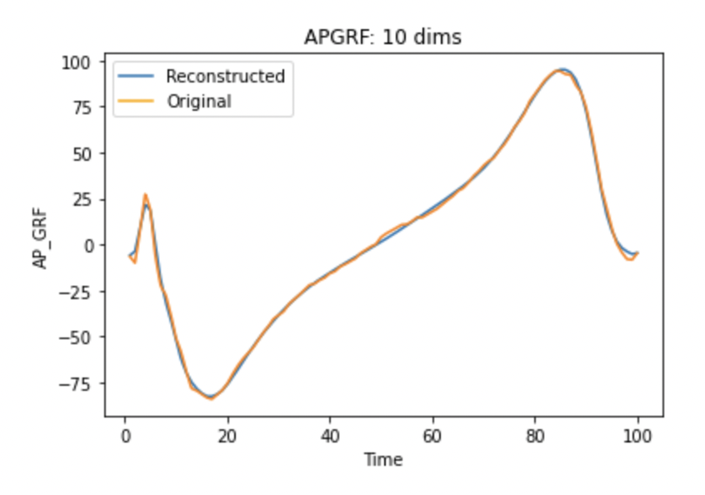
APGRF VAE Reconstruction Plots
Notes:
The reconstructions generally got better as dimensions increased

Slide 8
Final Steps
Something to try (but won’t be able to)
Train VAE for ML_GRF
Analyse the Latent space(Outlier Analysis? Clustering in Latent Space?)
Finalise report
VAE with LSTM layers
Conditional VAE
Notes:
Training VAEs takes a long time. Training for VGRF took 6 hrs and APGRF took 12 hrs. We are yet to train for MLGRF.
Next, We also want to do some kind of analysis on the latent space, we have a couple of ideas, but we are not sure yet.
We are also working on compiling a report

Slide 9
The End

